Slide 1
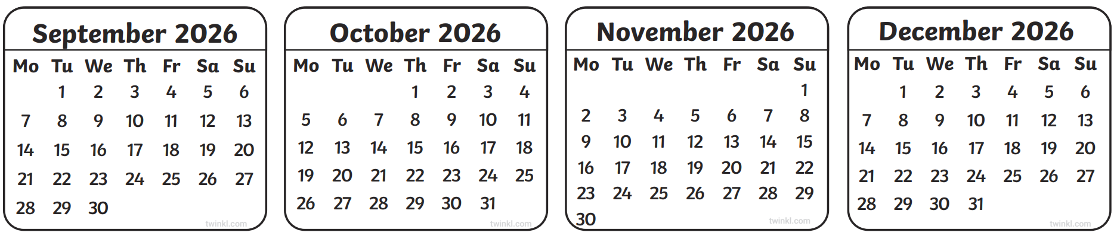
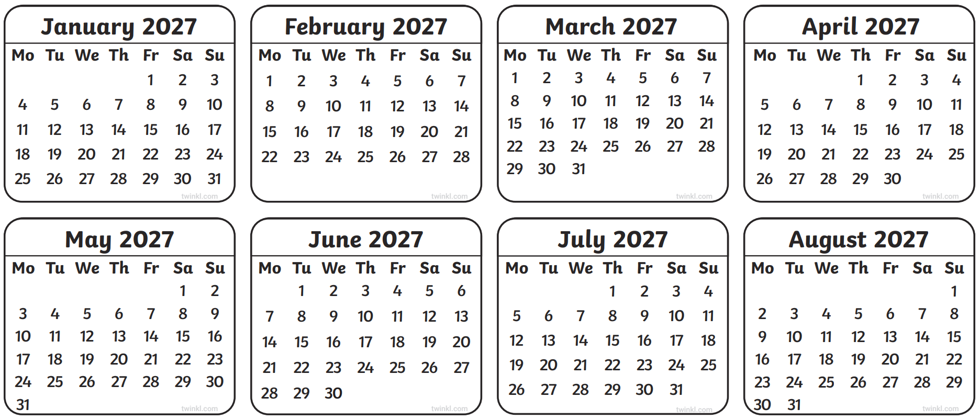
September 2026
October 2026
November 2026
December 2026
5
3
31
5
12
10
7
12
19
17
14
19
26
24
21
26
31
28
January 2027
February 2027
March 2027
April 2027
2
6
6
3
9
13
13
10
16
20
20
17
23
27
27
24
30
May 2027
June 2027
July 2027
August 2027
1
5
8
12
15
19
22
26
29

Slide 2
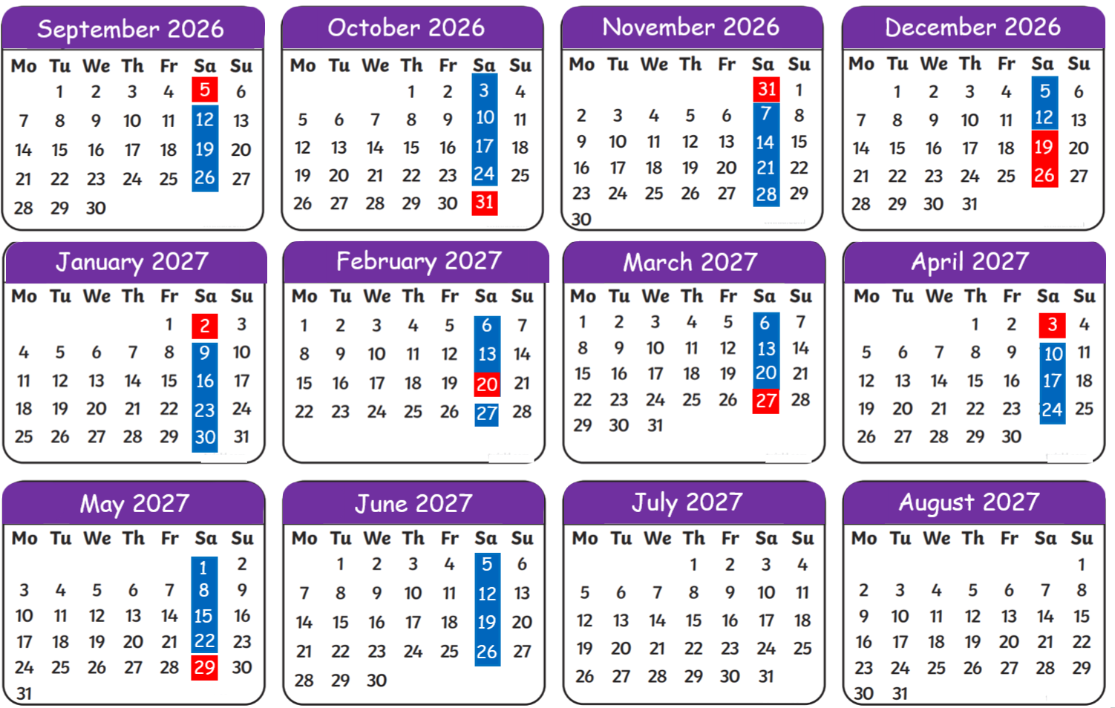
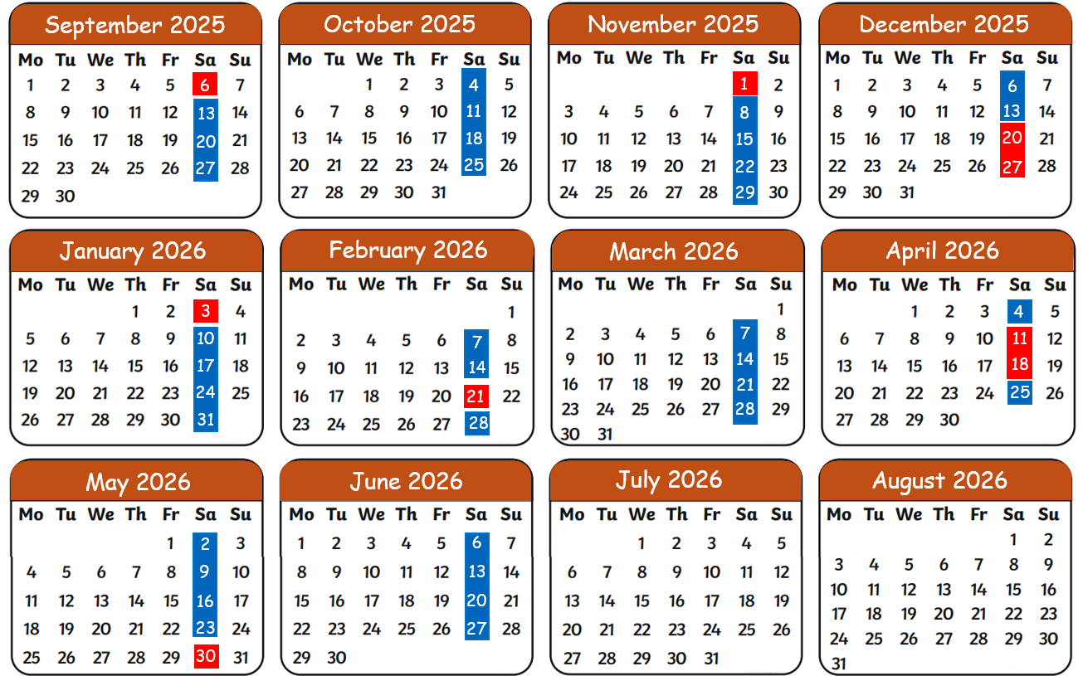
Term Dates
School Holidays list 2026-2027
School is open on days marked in blue.
School is closed on days marked in red.

